Slide 1
Introduction to Computer Architecture

Slide 2
Overview
John Von Neumann
John Von Neumann Architecture
Two types of computers
Stored programmed computers
RAM
CPU
Decimal (base 10)
Binary (base 2)
Decimal to Binary (Exercise)
Binary to Decimal (Exercise)
ASCII
Hexadecimal
Decimal to Hexadecimal (Exercise)

Slide 3
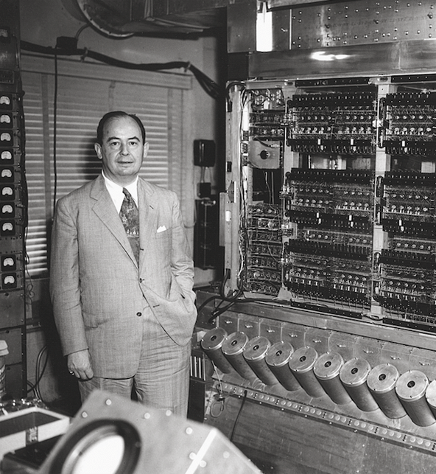
John von Neumann (1903-1957)
Hungarian-American
Mathematician, physicist, computer scientist and polymath.
Great contributions to quantum mechanics, game theory, the digital computer, nuclear physics and cellular automata.
Was a big part of the Manhatten Project.
In computer science he is very known for the “Von Neumann Architecture”

Slide 4
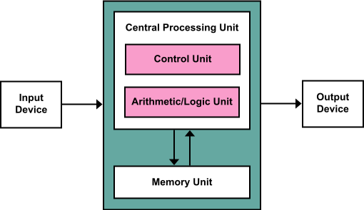
Von Neumman Architecture

Slide 5
Two types of computer
Fixed programmed computers
Very specific functionality
They could really only do one thing
Not re-programmable
An example could be a calculator
Stored programmed computers (Von Neumann Architecture)
Can be programmed to carry out many different tasks
Applications are stored on the computer.
Data and instructions are stored in memory and are treated the same (meaning they can be accessed the same way)

Slide 6
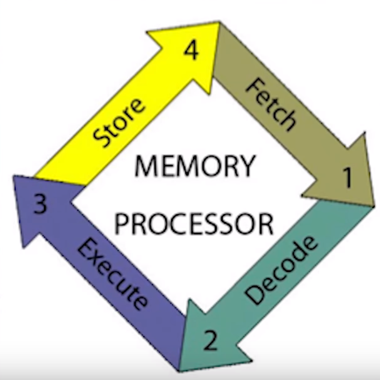
Stored programmed computers
Operates in four steps - called machine cycle
Fetch
Decode
Execute
Store

Slide 7
Memory
RAM (Random Access Memory)
Fast and inexpensive
Volatile (if power is lost, the data is lost)
Main location where instructions and output are loaded.
Cache
Much faster than RAM
More expensive
Located on the CPU (but in the Von Neumann architecture it is still part of the memory unit)
Can be accessed very quickly by the CPU
L1 cache fastest, located in the middle of a CPU core.
L2 cache is slower, and is located on the edge of a core, allowing it to be larger.
L3 is located across all the cores of a CPU it helps the cores communication with each other. It is the largest, but not anywhere near the size of RAM.
Secondary memory (storage)
Hard drive/SSD
Largest capacity
Not volatile
Much slower
Virtual memory (if you run out of RAM)

Slide 8
CPU (Central Processing Unit)
Today most CPU’s has multiple cores
Works as individual CPUs to split up tasks.
Resulting in increased performance
The CPU has two main components
Control Unit
Accesses the instructions in sequence, interprets them and controls the operations.
The main part of a control unit is called the program counter, which increments after each step in a program.
The control unit control the flow of the steps in the program counter and determine if the program should repeat a step, go back, go forward or stop.
Arithmetic logic unit
Is responsible for the operation of the steps in the program.
Modern CPUs has a floating point unit, a more advanced unit dealing with arithmetic.
Arithmetic are operations involving addition, subtraction and the like.
Logic are Boolean tests like true and false operations (conditionals).

Slide 9
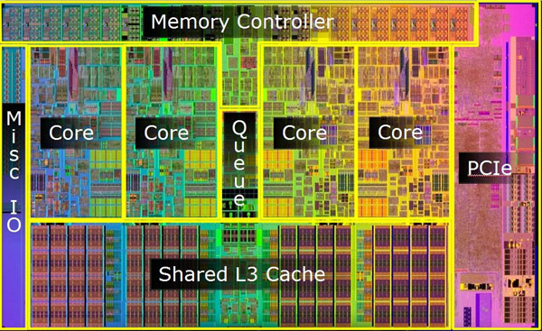

Slide 10
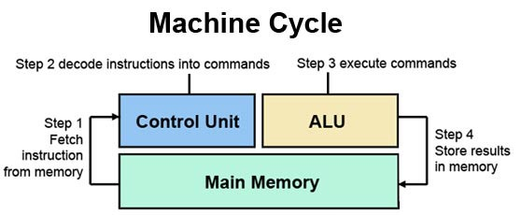
Machine Cycle

Slide 11
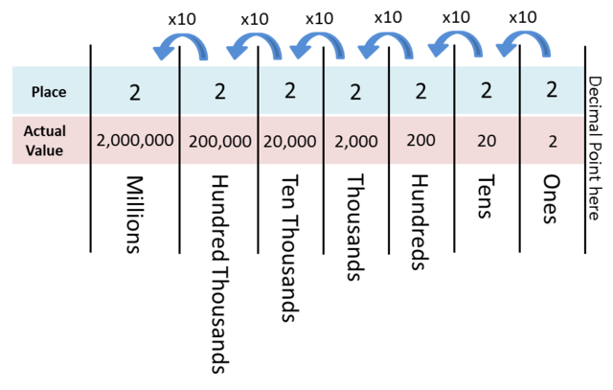
Base ten number system (decimal)

Slide 12
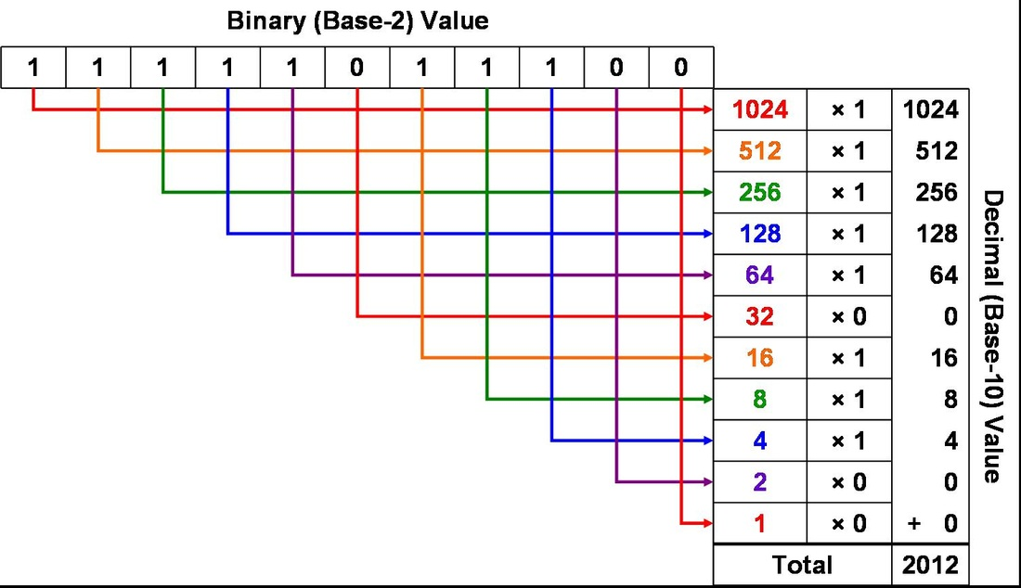
Base two (Binary)

Slide 13
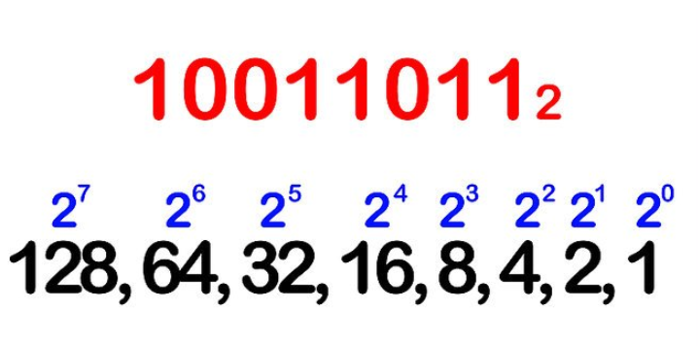

Slide 14
Binary task
Convert the following numbers from decimal to binary
10
55
255
130
Convert the following binary to decimal
‭00110111‬
‭11011110‬
0000‭1010‬
‭00101101‬

Slide 15
Decimal to Binary program (Exercise)
Create a method named GetBinary
The method should take a parameter of type int and return a string, so the method declaration is the following:
public static string GetBinary (int decimalNumber)
The method should return a string containing the binary representation of the decimal number.
An example would be calling the method “GetBinary(55)” .
the return value should be “‭00110111‬”.

Slide 16
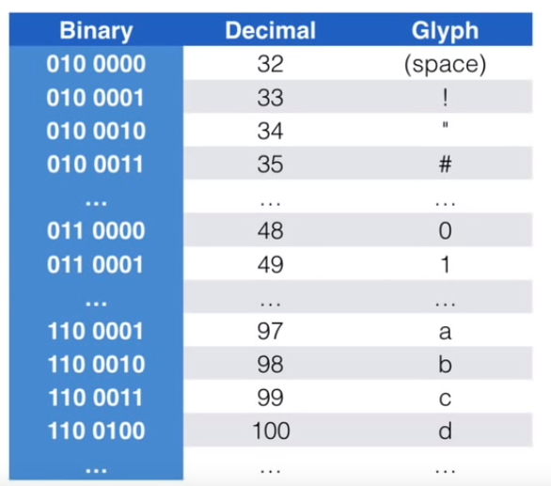
ASCII
Stands for ”American standard code for information interchange”
Based on the English alphabet
Code used to simplify working with characters
Includes [a-z], [A-Z],[0,9] - as well as other symbols.
01001000 01101001 translated to ASCII is “Hi”.

Slide 17
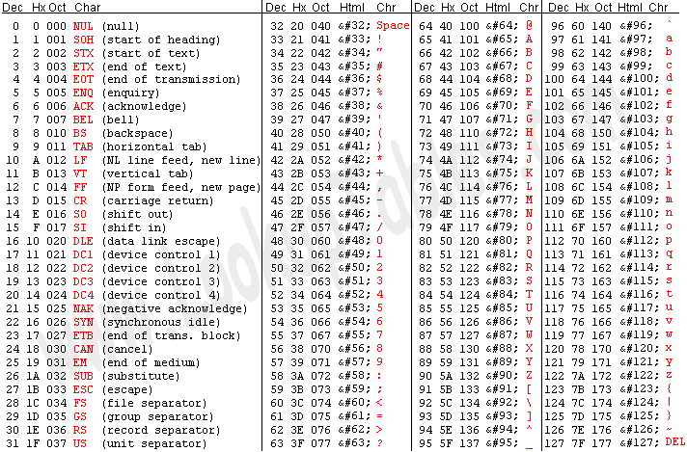
ASCII Table

Slide 18
Binary to Decimal program (Exercise)
Create a method named GetDecimal
The method should take a parameter of type string and return a int, so the method declaration is the following:
public static int GetDecimal(string binary)
The method should return a int containing the decimal representation of the binary number.
An example would be calling the method “GetDecimal(“11111111”)” .
the returned value should be 255.

Slide 19
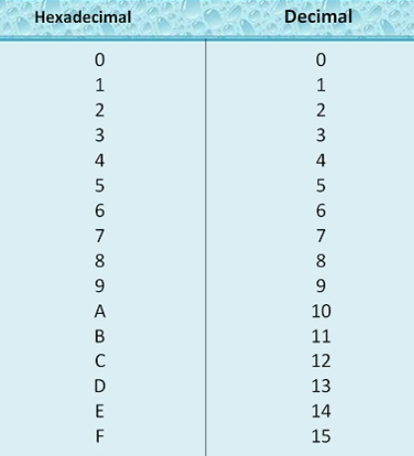
Hexadecimal (base 16)

Slide 20
Decimal to Hexadecimal(Exercise)
Create a method named GetHexadecimal
The method should take a parameter of type int and return a string, so the method declaration is the following:
public static string GetHexadecimal(int decimalNumber)
The method should return a string containing the decimal representation of the binary number.
An example would be calling the method “GetHexadecimal(255)” .
the returned value should be “‭FF‬‬”.

